Slide 1
TWITTER SENTIMENT ANALYSIS

Slide 2
01
Introduction & Background

Slide 3
Introduction
Twitter: A global platform where millions of users share their thoughts and opinions in real-time, making it a goldmine for understanding public sentiment.
Sentiment Analysis: The computational process of automatically identifying and categorizing opinions expressed in text as positive, negative, or neutral.
The Challenge: Twitter's unique characteristics, such as the 280-character limit, frequent use of hashtags, and informal language, present significant challenges for accurate sentiment analysis.

Slide 4
Project Goals
Develop: A high-performing deep learning model for sentiment analysis on Twitter data.
Label: Tweets with diverse sentiments (positive, negative, neutral, irrelevant) with high accuracy.
Address: Challenges posed by informal language, hashtags, and other Twitter-specific features.

Slide 5
Background on Sentiment Analysis
Sentiment Analysis (Opinion Mining): A multidisciplinary field that combines Natural Language Processing (NLP), Machine Learning, and Linguistics to extract subjective information from text.
The Process: Involves text preprocessing, feature extraction, and classification using sophisticated machine learning algorithms.
Twitter-Specific Challenges: The character limit, informal language, abundant use of hashtags and emoticons, sarcasm, irony, multilingual tweets, and the real-time nature of Twitter data all contribute to the complexity of sentiment analysis on this platform.

Slide 6
Deep Learning
Deep Learning: A subfield of machine learning that utilizes artificial neural networks with multiple layers to learn complex patterns in data, making it well-suited for the nuances of sentiment analysis.
Recurrent Neural Networks (RNNs): Designed to process sequential data like text, where the meaning of a word can depend on the words that come before and after it.
Long Short-Term Memory (LSTM): A specialized type of RNN that excels at capturing long-range dependencies in text, essential for understanding sentiment in longer tweets.
Bidirectional LSTM (BiLSTM): Processes text in both forward and backward directions, allowing the model to consider the full context of a word for even more accurate sentiment analysis.

Slide 7
Our Model Development Process
Preprocessing: A meticulous process involving text cleaning (removing URLs and irrelevant characters), tokenization (breaking text into words), lowercasing, stop word removal (eliminating common words like "the" and "is"), lemmatization (reducing words to their base form), and sequence padding (ensuring all text inputs are the same length).
Model Architecture: A carefully designed structure consisting of an embedding layer (converting words into numerical representations), a BiLSTM layer (capturing contextual information), a dropout layer (preventing overfitting), a dense layer (further processing information), and an output layer (producing the final sentiment classification).
Hyperparameter Tuning: An iterative process of optimizing various model settings, such as the embedding dimension, number of LSTM units, dropout rate, batch size, and learning rate, to achieve the best possible performance.

Slide 8
Evaluating Our Model's Performance
Accuracy: Our model achieved an impressive accuracy of 88.46% on a diverse set of test tweets, demonstrating its effectiveness in accurately classifying sentiment.
Confusion Matrix: A detailed table that provides a deeper understanding of the model's performance by showing how often it correctly and incorrectly classifies each sentiment category.
Training and Validation Curves: Visual representations that illustrate how the model's accuracy and loss (error) changed over time during training, providing insights into its learning process and stability.

Slide 9
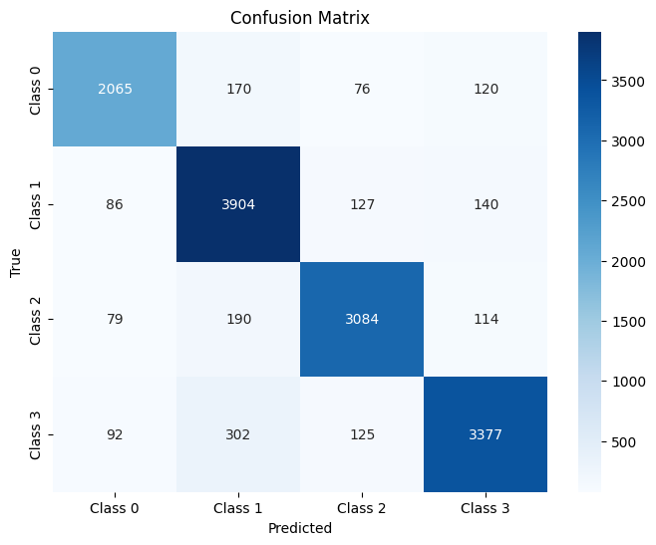

Slide 10
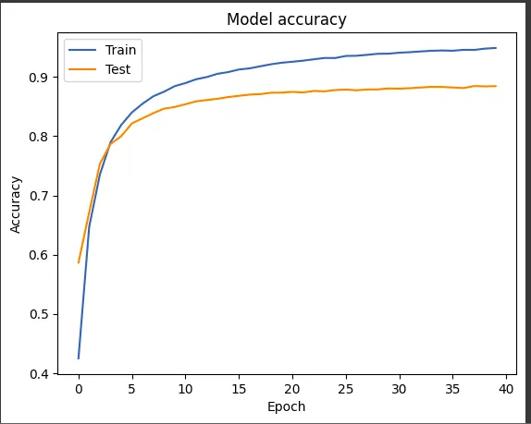

Slide 11
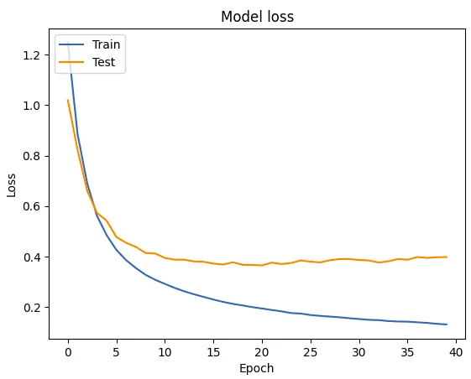

Slide 12
CODE SNIPPETS

Slide 13
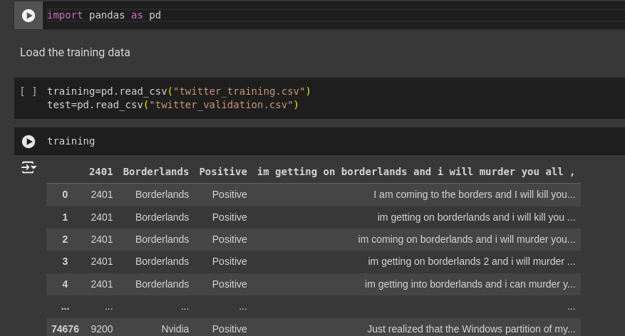

Slide 14
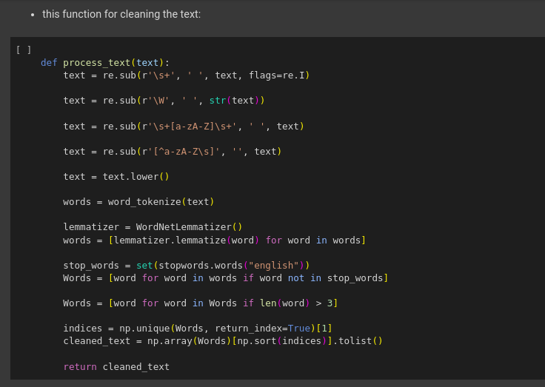

Slide 15
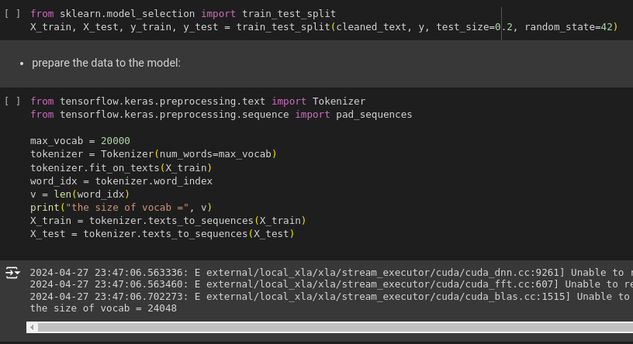

Slide 16
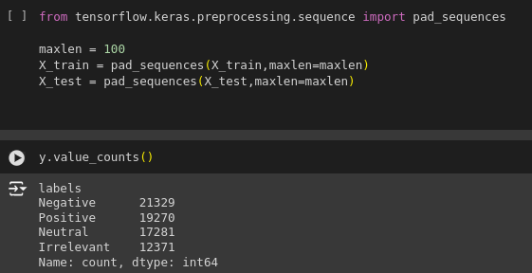

Slide 17
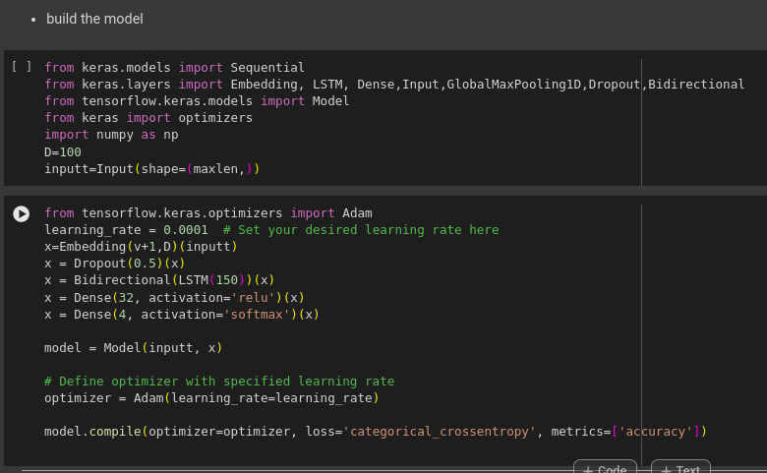

Slide 18
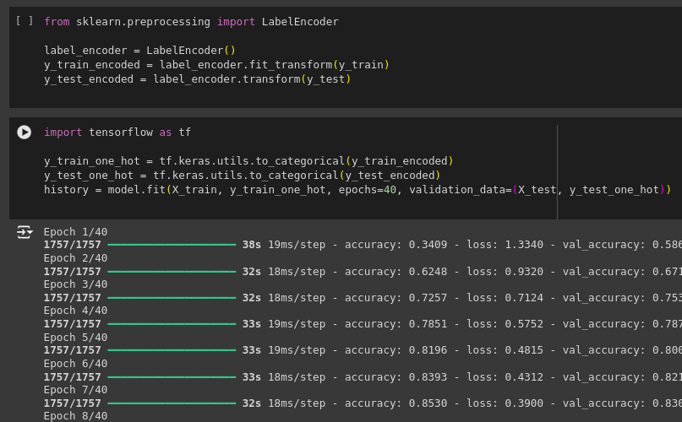

Slide 19
CONCLUSION
Success: We have successfully developed a high-performing BiLSTM model that tackles the challenges of sentiment analysis on Twitter data, achieving impeccable accuracy.
Impact: Our model has the potential to revolutionize social media monitoring, market research, political analysis, and other fields where understanding public opinion is crucial.
Future Work: We will continue to refine our model by addressing the challenge of classifying neutral sentiments and exploring the use of additional features, such as emojis and user profiles, to further enhance accuracy.

